Slide 1
Probability

Slide 2
Probability
Numerical measure of likelihood that an event will occur.
The probability of any event must be between 0 and 1, inclusive.
The sum of all probabilities across all events (or integral of the area under a curve if continuous) must be 1.

Slide 3
Approaches to Assigning Probabilities
There are three ways to assign a probability, P(O_{i} ), to an outcome, O_{i} , namely:
Classical approach: based on equally likely events.
Relative frequency: assigning probabilities based on experimentation or historical data.
Subjective approach: Assigning probabilities based on the assignor’s (subjective) judgment

Slide 4
Classical Approach
If an experiment has n possible outcomes, this method would assign a probability of 1/n to each outcome. It is necessary to determine the number of possible outcomes.
Rolling a die
{1, 2, 3, 4, 5, 6}
Each sample point has a 1/6 chance of occurring.
Experiment: Outcomes Probabilities:

Slide 5
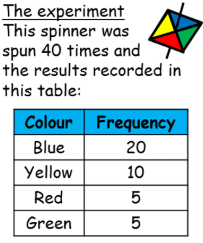
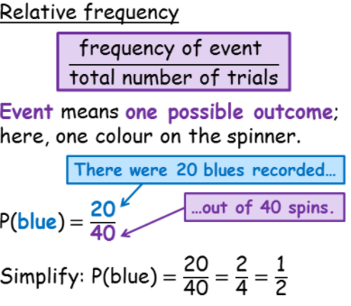
Relative Frequency Approach

Slide 6
Subjective Approach
“In the subjective approach we define probability as the degree of belief that we hold in the occurrence of an event”
E.g. weather forecasting’s “P.O.P.”
POP 60% – based on current conditions, there is a 60% chance of rain (say).

Slide 7
Terminology
Experiment
Trial
Event
Elementary Event

Slide 8
Sample space
The set of all elementary events for an experiment is called a sample space.
Suppose if you roll a die, there are you can get 1 2 3 4 5 6 these are the sample space there are different methods for describing the sample space one is listing tree diagram, set builder notation and Venn diagram, you will see what is that.

Slide 9
Probabilities of events
We study methods to determine probabilities of events that result from combining other events in various ways.
There are several types of combinations and relationships between events:
Complement event
Intersection of events
Union of events
Mutually exclusive events
Dependent and independent events

Slide 10
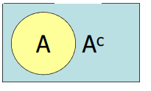

Complement of an Event
The complement of event A is defined to be the event consisting of all sample points that are “not in A”.
Complement of A is denoted by A^{c}
The Venn diagram below illustrates the concept of a complement.
For example, the rectangle stores all the possible tosses of 2 dice {(1,1), 1,2),… (6,6)}
Let A = tosses totaling 7 {(1,6),(2, 5), (3,4), (4,3), (5,2), (6,1)}
P(Total = 7) + P(Total not equal to 7) = 1

Slide 11
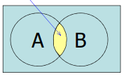
intersection of Two Events
The intersection of events A and B is the set of all sample points that are in both A and B.
The intersection is denoted: A and B
The joint probability of A and B is the probability of the intersection of A and B,i.e. P(A and B)

Slide 12

Union of Two Events
The union of two events A and B, is the event containing all sample points that are in A or B or both: Union of A and B is denoted: A or B
For example, let A = tosses where first toss is 1 {(1,1), (1,2), (1,3), (1,4), (1,5), (1,6)} and
B is the tosses that the second toss is 5 {(1,5), (2,5), (3,5), (4,5),(5,5), (6,5)}
Union of A and B is {(1,1), (1,2), (1,3), (1,4), (1,5), (1,6),(2,5), (3,5), (4,5), (5,5), (6,5)}

Slide 13

Mutually Exclusive Events
When two events are mutually exclusive (that is the two events cannot occur together), their joint probability is 0, hence:
Mutually exclusive; no points in common…
For example A = tosses totaling 7 and
B = tosses totaling 11

Slide 14
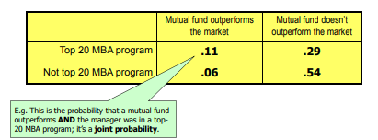
Example
Why are some mutual fund managers more successful than others? One possible factor is where the manager earned his or her MBA. The following table compares mutual fund performance against the ranking of the school where the fund manager earned their MBA:

Slide 15

Alternatively, we could introduce shorthand notation to represent the events:
A1 = Fund manager graduated from a top-20 MBA program
A2 = Fund manager did not graduate from a top-20 MBA program
B1 = Fund outperforms the market
B2 = Fund does not outperform the market
E.g. P(A2 and B1) = .06 = the probability a fund outperforms the market and the manager isn’t from a top-20 school.

Slide 16
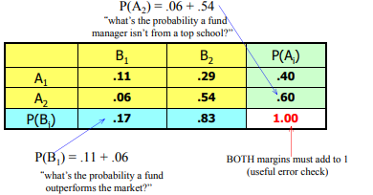
Marginal Probabilities
Marginal probabilities are computed by adding across rows and down columns; that is they are calculated in the margins of the table:

Slide 17



Conditional Probability
Conditional probability is used to determine how two events are related; that is, we can determine the probability of one event given the occurrence of another related event. Conditional probabilities are written as P(A | B) and read as “the probability of A given B” and is calculated as:
Again, the probability of an event given that another event has occurred is called a conditional probability…

Slide 18
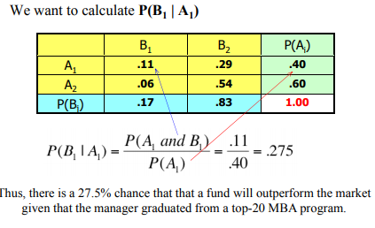
Example What’s the probability that a fund will outperform the market given that the manager graduated from a top-20 MBA program?
Recall:
A1 = Fund manager graduated from a top-20 MBA program
A2 = Fund manager did not graduate from a top-20 MBA program
B1 = Fund outperforms the market
B2 = Fund does not outperform the market
Thus, we want to know “what is P(B1 | A1)

Slide 19
Independence
One of the objectives of calculating conditional probability is to determine whether two events are related.
In particular, we would like to know whether they are independent, that is, if the probability of one event is not affected by the occurrence of the other event.
Two events A and B are said to be independent if
P(A|B) = P(A) or P(B|A) = P(B)
For example, we saw that P(B1 | A1) = .275
The marginal probability for B1 is: P(B1) = 0.17
Since P(B1|A1) ≠ P(B1), B1 and A1 are not independent events.
Stated another way, they are dependent.
That is, the probability of one event (B1) is affected by the occurrence of the other event (A1).

Slide 20
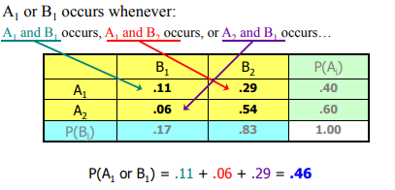
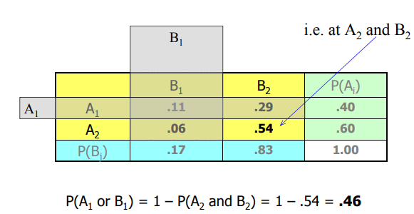
Union Example:
Determine the probability that a fund outperforms (B1) or the manager graduated from a top-20 MBA program (A1).

Slide 21
Probability Rules and Trees
We introduce three rules that enable us to calculate the probability of more complex events from the probability of simpler events…
The Complement Rule,
The Multiplication Rule, and
The Addition Rule

Slide 22
Complement Rule
As we saw earlier with the complement event, the complement rule gives us the probability of an event NOT occurring.
That is: P(AC) = 1 – P(A)
For example, in the simple roll of a die, the probability of the number “1” being rolled is 1/6
The probability that some number other than “1” will be rolled is 1 – 1/6 = 5/6.

Slide 23
Multiplication Rule
The multiplication rule is used to calculate the joint probability of two events. It is based on the formula for conditional probability defined earlier:
If we multiply both sides of the equation by P(B) we have:
P(A and B) = P(A | B)•P(B)
Likewise, P(A and B) = P(B | A) • P(A)
If A and B are independent events, then P(A and B) = P(A)•P(B)

Slide 24
Example
A graduate statistics course has seven male and three female students. The professor wants to select two students at random to help her conduct a research project. What is the probability that the two students chosen are female? probability that the two students chosen are female?
Let A represent the event that the first student is female P(A) = 3/10 = .30
Let B represent the event that the second student is female P(B | A) = 2/9 = .22
That is, the probability of choosing a female student given that the first student
chosen is 2 (females) / 9 (remaining students) = 2/9
Thus, we want to answer the question: what is P(A and B) ?
P(A and B) = P(A)•P(B|A) = (3/10)(2/9) = 6/90 = .067
“There is a 6.7% chance that the professor will choose two female students from her grad class of 10.”

Slide 25
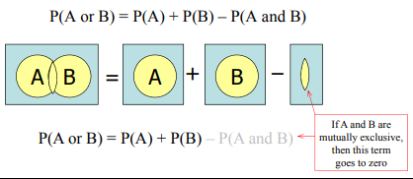
Addition Rule
Recall: the addition rule is used to compute the probability of event A or B or both A and B occurring; i.e. the union of A and B.

Slide 26
Example
In a large city, two newspapers are published, the Sun and the Post. The circulation departments report that 22% of the city’s households have a subscription to the Sun and 35% subscribe to the Post subscribe to the Post. A survey reveals that 6% of all households subscribe to both newspapers. What proportion of the city’s households subscribe to either newspaper?
P(Sun or Post) = P(Sun) + P(Post) – P(Sun and Post)
= .22 + .35 – .06 = .51
“There is a 51% probability that a randomly selected household subscribes to one or the other or both papers”

Slide 27
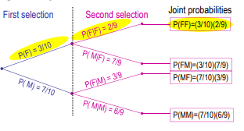
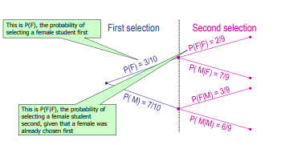
Probability Trees
An effective and simpler method of applying the probability rules is the probability tree, wherein the events in an experiment are represented by lines. The resulting figure resembles a tree, hence the name. We will illustrate the probability tree with several examples, including two that we addressed using the probability rules alone.

Slide 28
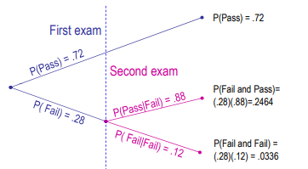
Example
Law school grads must pass a bar exam. Suppose pass rate for first-time test takers is 72%. They can re-write if they fail and 88% pass their second attempt. What is the probability that a randomly grad passes the bar?

Slide 29
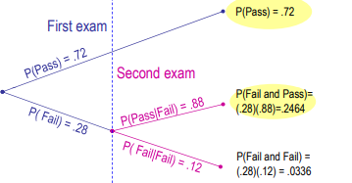
What is the probability that a randomly grad passes the bar?
“There is almost a 97% chance they will pass the bar”
P(Pass) = P(Pass 1st) + P(Fail 1st and Pass 2nd)
= 0.7200 + 0.2464 = .9664

Slide 30
Bayes’ Law
Bayes’ Law is named for Thomas Bayes, an eighteenth century mathematician.
In its most basic form, if we know P(B | A),
we can apply Bayes’ Law to determine P(A | B)

Slide 31
The probabilities P(A) and P(AC) are called prior probabilities because they are determined prior to the decision about taking the preparatory course.
The conditional probability P(A | B) is called a posterior probability (or revised probability), because the prior probability is revised after the decision about taking the preparatory course.

